Slide 1
Modular Programming(9-dars)
Davronbek Malikov

Slide 2
Bugun
Project 3: Discussion
Takrorlash
Data Preprocessing Pipeline:
Manual
Auto
Data Preprocessing amaliy
Model Training Pipeline amaliy
Vazifa

Slide 3
Project 3: Discussion

Slide 4
Takrorlash

Slide 5

Takrorlash
Project 3 xolati va savol javob
Takrorlash
Pipeline in ML:
Data Loading
Data Preprocessing
Manual Preprocessingda muammolar
Auto Pipeline
Vazifa

Slide 6

Auto Pipeline
ColumnTransformer:
Barcha transformation avtomatik kechadi:
Numeric → Missing values,MinMaxScaler, StandardScaler
Categorical → Missing values, OneHotEncoder, LabelEncoder

Slide 7
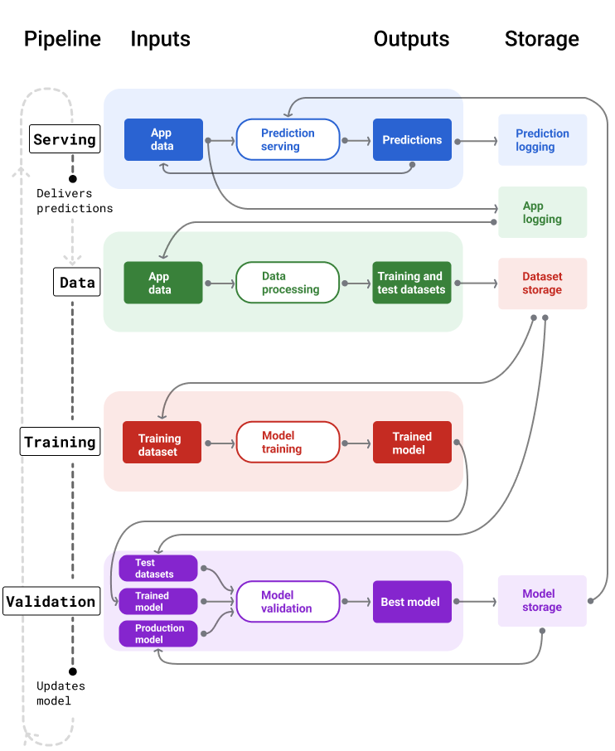

Auto Pipeline
ML: Pipeline

Slide 8
Auto Pipeline
Asosiy +:
Production-ready
Clean & maintainable
Automatic handling of new data inputs

Slide 9
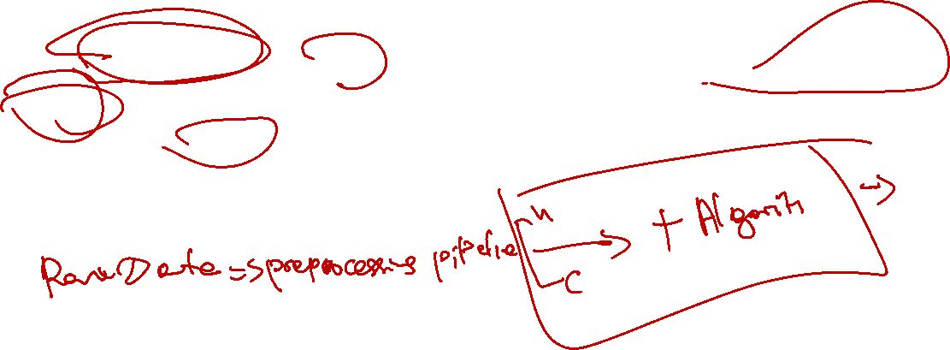
Auto Pipeline
Asosiy componentlar:
ColumnTransformer– Turli xil ustunlarni birgalikda ketishini taminlaydi
Pipeline---Preprocessing + Algorithmni birlashtiradi
Automates workflow, reproducible, deployable

Slide 10

Auto Pipeline
Qo’shimcha componentlar:
OrdinalEncoder→LabelEncoder
handle_uknown:
Error
Ignore
(handle_unknown='use_encoded_value', unknown_value=-1)
One-hot encoder:
Handle_unknown=‘ignore’(nol)

Slide 11

Auto Pipeline
Asosiy +:
Production-ready
Clean & maintainable
Automatic handling of new data inputs
Automation: Users only provide raw input
Preprocessing is automatic.
Consistency: No risk of forgetting scaling or encoding steps.

Slide 12
Auto Pipeline: Amaliy

Slide 13
Vazifa

Slide 14

Vazifa
3-Project kamchiliklarini ro’yhatini tuzing va taxlil qiling
9-dars uchun Report yozing
Final uchun Projectni 12-dars uchun tayyorlang
Alohida fileda kichik dataset bn Pipelinedan foydalangan xolda preprocessing

